Slide 1
Accessible Virtual Meetings
January 13, 2021

Slide 2
Introduction
Gerard Williams
Section 504 Compliance Officer, Federal Communications Commission
Nationally Certified American Sign Language Interpreter (NIC Advanced)
Brandon Pace
HQ Section 508 Program Manager, U.S. Department of Homeland Security
Former President of Deaf & Hard-of-Hearing DHS (employee resource group)
Certified Professional in Accessibility Core Competencies
Notes:
Disclaimer- we do not speak for all people with disabilities. The experts on accommodations and inclusion of people with disabilities are those people themselves. We are able to provide guidelines and thoughts to consider, but do not consider this canon.
Another disclaimer: We do NOT endorse any companies, organizations, providers, products, or services that will be mentioned during our presentation.

Slide 3
Disclaimer
The assessments provided herein should not be construed to be an endorsement or approval by the Federal Government of any specific platform or program.
No representations are made in this presentation as to whether or how certain platforms are or are not in compliance with legal or regulatory requirements from FCC, DHS, or other Federal agencies or legislation.
To view this presentation in context with presenter remarks, please see: https://www.youtube.com/watch?v=rR9RfhvM2sU

Slide 4
Agenda
Accommodations vs. Accessibility
Challenges and Opportunities
Best Practices
Equipment and Technology Recommendations
Virtual Conferencing Platforms Overview
Zoom
Cisco WebEx
Google Meet
Adobe Connect
Microsoft Teams
Live Streaming (e.g. YouTube, Facebook, Twitter)
So how do I pick a platform?
Q&A Session

Slide 5
Quote to share
“
For most people, technology makes things easier. For people with disabilities, however, technology makes things possible.
Mary Pat Radabaugh
Director of IBM’s National Support Center for People with Disabilities
1998
”
Notes:
Brandon to lead

Slide 6
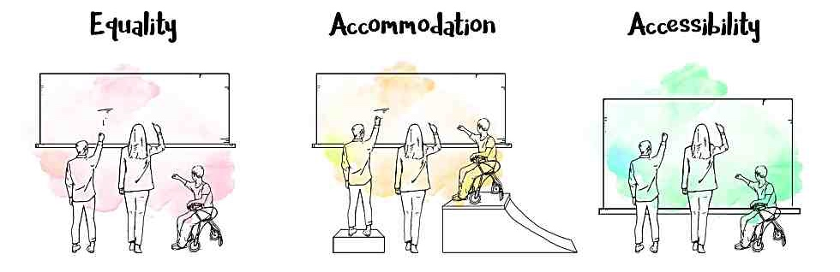
Reminder...
Accommodation is not the same as accessibility.
Accommodations are for individuals and are reactive.
Accessibility is for populations and is proactive.
Accessibility should make content available to all, in equally effective ways, at the same time.
Accessibility is the goal, accommodations are just tools to reach it.
Notes:
Types of Accommodations:
Interpreters (American Sign Language (ASL), Tactile ASL, or Protactile)
Support Service Provider, sighted guide, personal assistant
Real-time captioning (CART)
Automatic Speech Recognition* (AKA: automated/live captions)
Assistive Listening Devices
Documents in alternate formats
Braille or Large print
Audio format (text-to-speech)
Electronic methods (email or CD)
Note taking
Extended breaks
Seating locations

Slide 7
Virtual Meetings: Challenges
Platform limitations (Technical)
Environmental limitations (Security, budgetary)
Licensing limitations
Some features not uniformly available (e.g. higher-tier licenses).
Diverse access methods/user interface (UI)
Inconsistent user experience
Limited ability to provide technical support
Screen share does not share screen share tools
Turn taking awkwardness
Lack of access to conversational cues
Conflicting accommodations
Limited screen space and bandwidth
Lack of experience and/or training
Low Demands High
Low Controls High
Notes:
Gerard to Lead
Bullet 4- DeafBlind access!! Other users w/o broadband, technology, etc. INCOME INEQUALITY; PWD under/unemployed at higher rates, higher rate of poverty, less access to expensive technology (Not every accessibility feature comes down to equity for all different types of disabilities. )

Slide 8

Virtual Meetings: Opportunities
Interface customization
User control of Assistive Technology
Expanded pool of participants
Geographic, disability, time
Productivity
Richer remote interactions (as opposed to “conference call”)
…?
Notes:
Gerard to lead

Slide 9
Virtual Meetings: Universal Meeting Design
Establish a single Point of Contact
Ask for help
Do a technology test in advance
Broadcast the Communication Rules
Sample at the beginning of this presentation
Embrace good meeting management techniques
Notes:
Brandon to Lead
Universal design- good meeting practices that help make a meeting more inclusive also make it more PRODUCTIVE for all participants, not just PWD.
Establish a single Point of Contact for meeting logistics and accommodations
Obtain technical support when and if needed
Provide the option for a technology test prior to your meeting.
Implement good meeting management techniques
Develop and distribute Communication Rules prior to your meeting, and review them at the start of every meeting
For example: If you’re not talking, mute your mic/phone and turn off video.
Only one person can talk at a time -- digital audio is not the same as 3D audio if we’re in the same room so if 2 people are talking at the same time, the audio broadcasts out to everybody else as inaudable.

Slide 10





Meeting Management Techniques
Agenda: Distribute a detailed agenda prior to your meeting*
Attendee List: Make available a list of confirmed attendees
Moderator: Assign one participant to serve as meeting moderator
Name Announcements: Remind participants to identify themselves before they begin to speak
Manage turn-taking: Establish a clear procedure (or utilize a digital tool) to manage turn taking
Document sharing: Distribute any relevant documents well in advance of the meeting*
*Any/all document distribution should consider accessibility of those documents (e.g. word format, PDF, plaintext, braille, videos to be captioned & audio described)
Notes:
Brandon to lead

Slide 11



Meeting Management Techniques - continued
Communication style: Describe the content of the graphics, speak at a moderate rate and stay on topic for ease of communication
Check In: At the beginning of your meeting take a moment to ask whether all attendees have what they need for effective communication.
Solicit Feedback: Provide a contact for and specifically solicit feedback on accessibility of the meeting.
Screen share sparingly: Screen/content is not accessible to screen readers users and can take screen space away from video that may be needed. Use with caution and consider toggling shared content on and off only when needed.
Notes:
Gerard to lead
screen/content share is traditionally not accessible to screen reader users regardless of platform

Slide 12



Equipment and Tech Recommendations
Fine tune your audio
Use a headset whenever possible
Split your audio between input and output; input via device’s built-in microphone, output to headphones or other isolated audio device
Only use one audio connection method (phone or computer, not both)
Fine tune your video
Frame your shot
Consider an external webcam
Disable autofocus if possible
Consider turning off your video when it is not needed*
Provide multiple connection options
Maintain flexibility for your attendees by allowing for as many different connections as possible (e.g. IP audio, phone audio, audio only, video only)
Notes:
Gerard to lead
This also allows for closer-to-duplex sound transmission. Using a computer’s speakers or speakerphone, or even a smart phone, engages echo cancellation algorithms that may prevent you or others from hearing multiple speakers, causing even more challenges in turntaking.

Slide 13



Equipment and Tech Recommendations - ASR
Different ASR performance on captioning
Example between 2 different platforms:
Microsoft Teams (using Microsoft Azure Speech AI)
Google Meetup (using Google Cloud Speech to Text AI
Edgar Allen Poe’s poem “The Raven”
Once Upon a midnight dreary.
While I pondered weak and weary.
Over many acquaint, incurious volume of
forgotten lore.
While I nodded, nearly napping, suddenly
there came a tapping.
As of someone gently wrapping wrapping up
my chambered or just some visitor I
muttered tapping at my chain. Would or
only this and nothing more.
Once Upon a Midnight dreary while I pondered
weak and weary over many a quaint and curious
volume of Forgotten lore while I nodded nearly
napping suddenly there came a tapping as of
someone gently rapping rapping at my chamber
door tis some visitor. I muttered tapping at my
chamber door only this and nothing more.
Notes:
Brandon to lead
Microsoft: Each line takes a moment as the AI visibly corrects itself. While this worked for the most part, in one case Teams actually had the right wording at first — “chamber door” — and then corrected that to “chambered or.”
Google: While Meet seemed to favor run-on sentences, its accuracy, at least with this one example, was well beyond that of Teams. This wasn’t surprising, since Google has been playing with voice recognition and captioning with several of its services.

Slide 14

Platforms: Zoom
Pros | Cons
Highly accessible via screen reader Simple intuitive User Interface (UI) Side by side mode/dual monitor support High quality video/audio with low stutter rate Non-video participants can be hidden Built-in support for captioning (via participant or vendor) Supports up to 100 video participants (350 total) Multi-pinning and multi-spotlight support Can move captions box around the window | Integrated meeting management tools lack sophistication Captioning display lacks customization, sophistication, consistency. Security concerns continue to be prevalent, especially amongst government entities Built-in live ASR using Otter.ai - but for Business or Pro accounts only (not gov)
Notes:
Gerard to lead
One of the most accessible platforms for users of screen readers
Simple intuitive UI allows for ease of use (all users, cognitive disabilities)
Side by side mode and dual monitor support
Allows for more flexibility for ASL users to retain video access while viewing content, and maximize video size
Integrated meeting tools lack sophistication
Handraising tool exists but doesn’t track order, may not be usable for screen reader users
Chat functions can be difficult to distinguish (PMs versus public chat)
Video quality is high
Non-video participants can be hidden to allow screen real estate to remain for signers
Allows for captioning support
Either via third party captioner, or a participant typing into the UI
Captioning display is variable and there are not many options for customizing the display, Brandon will show an example GIF of the captioning’s flaws on Zoom.
Security concerns

Slide 15
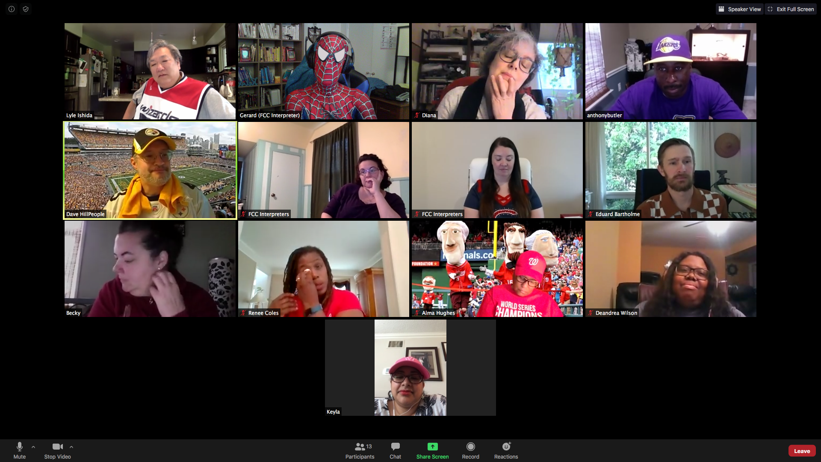
Platforms: Zoom
Notes:
Gerard to lead
One of the most accessible platforms for users of screen readers
Simple intuitive UI allows for ease of use (all users, cognitive disabilities)
Side by side mode and dual monitor support
Allows for more flexibility for ASL users to retain video access while viewing content, and maximize video size
Integrated meeting tools lack sophistication
Handraising tool exists but doesn’t track order, may not be usable for screen reader users
Chat functions can be difficult to distinguish (PMs versus public chat)
Video quality is high
Non-video participants can be hidden to allow screen real estate to remain for signers
Allows for captioning support
Either via third party captioner, or a participant typing into the UI
Captioning display is variable and there are not many options for customizing the display, Brandon will show an example GIF of the captioning’s flaws on Zoom.
Security concerns

Slide 16
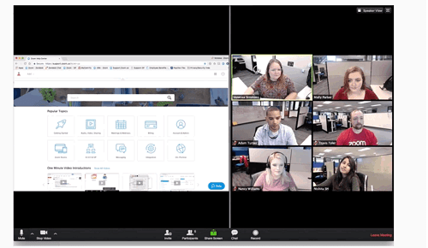
Platforms: Zoom
Notes:
Gerard to lead
One of the most accessible platforms for users of screen readers
Simple intuitive UI allows for ease of use (all users, cognitive disabilities)
Side by side mode and dual monitor support
Allows for more flexibility for ASL users to retain video access while viewing content, and maximize video size
Integrated meeting tools lack sophistication
Handraising tool exists but doesn’t track order, may not be usable for screen reader users
Chat functions can be difficult to distinguish (PMs versus public chat)
Video quality is high
Non-video participants can be hidden to allow screen real estate to remain for signers
Allows for captioning support
Either via third party captioner, or a participant typing into the UI
Captioning display is variable and there are not many options for customizing the display, Brandon will show an example GIF of the captioning’s flaws on Zoom.
Security concerns

Slide 17

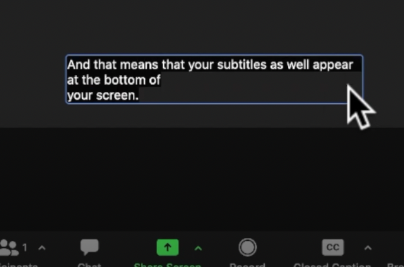
Platforms: Zoom (Placement of Captions)
Notes:
Brandon to lead
This slide is to show what most captioning looks like on Zoom. You may ask why is this happening? I’ll try to explain this in layman’s terms. Zoom does have API for captions which means it allows captioners or stenographers to be able to transmit the words from their stenograph software over to Zoom in order for the captions to appear. The challenges with this design is that Zoom’s systems are designed that every time when they recieve a new blob of data, it’ll be considered as a new line. With that in mind, there are 2 different solutions to fix this issue, but either one of these solutions falls completely upon either Zoom or the stenograph software. One solution is for Zoom to change their code to “amend” the captions so previous caption lines wouldn’t disappear when a new blob comes in. If Zoom wouldn’t do this, there’s another solution and that is for the stenograph software to be modified to keep the previous caption lines when sending a new blob with the new caption lines which leads me to show you the next slide.

Slide 18
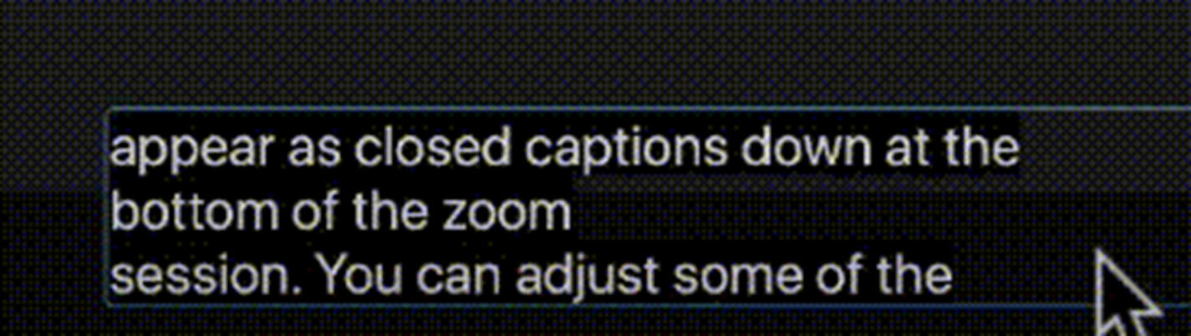
Platforms: Zoom (Roll-up captioning)
Notes:
Brandon to lead
Zoom finally released update to their captioning interface where it will display as roll-up captions which places them in a much better place from an accessibility angle.
Nevertheless, StreamText (or other standalone caption display) is the ultimate solution for users overall, especially for those who are DeafBlind or low-vision.

Slide 19
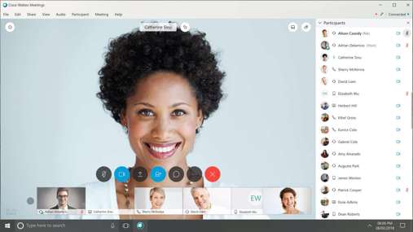

Platforms: Cisco WebEx
Pros | Cons
Easy to procure; security and enterprise ready Capability to create a separate module for captioning (Multimedia viewer) Centralized feature management (administrators) | Not usable for screen reader users. Complex user interface requires training to navigate Unintuitive video “pinning” functionality Inflexible video interface Centralized feature management (administrators) Additional steps to join a meeting
Notes:
Gerard to lead
WebEx
Unintuitive video “pinning” functionality
Pins are based on frames, not on individuals
“locking” a video with a pin removes flexibility for users to pin for themselves
Retaining flexibility and customization for users who need access to interpretation or other accommodations would mean not “locking” the display into one mode, unless that mode prioritizes all accommodations.
Inflexible video interface
Non video participants cannot be hidden, contributing to tiny videos on screen
More secure and enterprise ready
Not usable by screen reader users

Slide 20
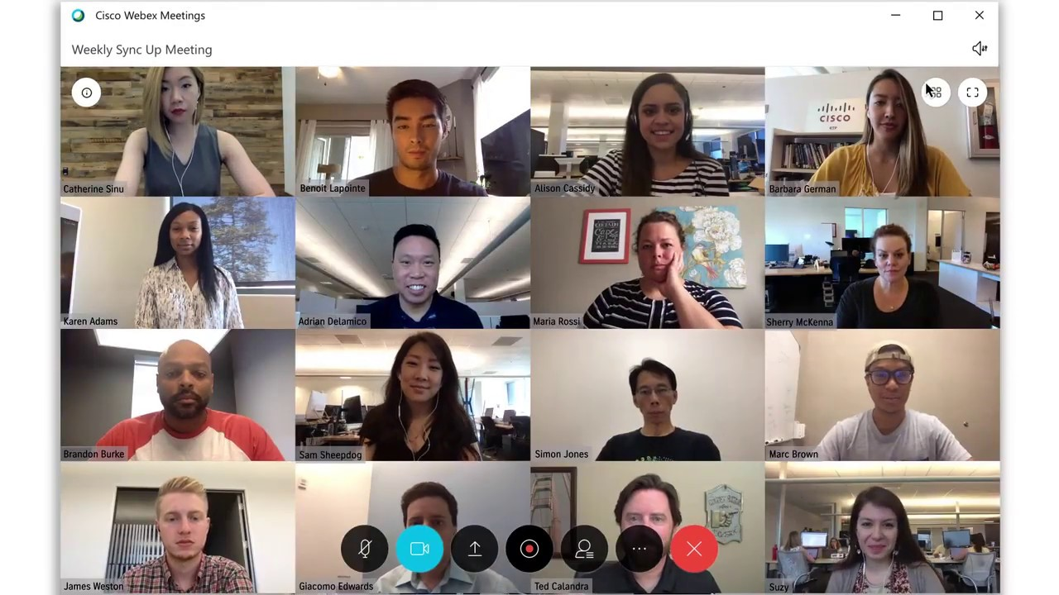
Platforms: Cisco WebEx
Notes:
Gerard to lead
WebEx
Unintuitive video “pinning” functionality
Pins are based on frames, not on individuals
“locking” a video with a pin removes flexibility for users to pin for themselves
Retaining flexibility and customization for users who need access to interpretation or other accommodations would mean not “locking” the display into one mode, unless that mode prioritizes all accommodations.
Inflexible video interface
Non video participants cannot be hidden, contributing to tiny videos on screen
More secure and enterprise ready
Not usable by screen reader users

Slide 21
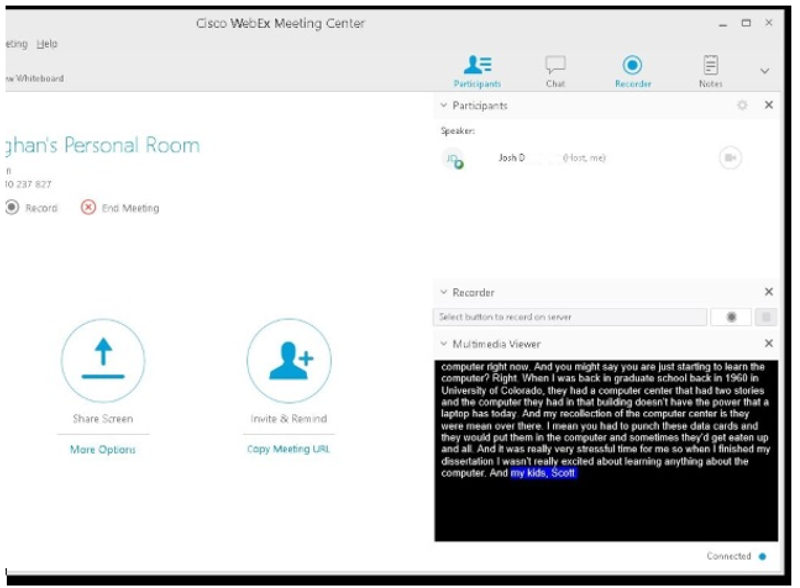
Platforms: Cisco WebEx
Notes:
Brandon to lead
WebEx
Unintuitive video “pinning” functionality
Pins are based on frames, not on individuals
“locking” a video with a pin removes flexibility for users to pin for themselves
Retaining flexibility and customization for users who need access to interpretation or other accommodations would mean not “locking” the display into one mode, unless that mode prioritizes all accommodations.
Inflexible video interface
Non video participants cannot be hidden, contributing to tiny videos on screen
More secure and enterprise ready
Not usable by screen reader users

Slide 22

Platforms: Google Meet
Pros | Cons
FedRAMP approved for some agencies Easy to use and intuitive Automated captioning has high accuracy and names speakers (isolated audio channels) Grid layout for video Screen reader and keyboard accessible Audio via phone connection Browser based- no download required | Not widely available to government agencies Max number of video participants depends on license (100, 150, 250)
Notes:
Brandon to lead

Slide 23
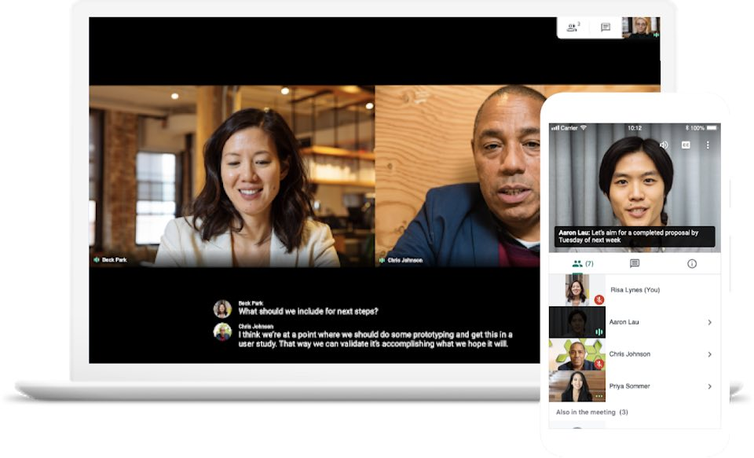
Platforms: Google Meet
Notes:
brandon to lead

Slide 24

Platforms: Adobe Connect
Pros | Cons
Majority of federal agencies use it Easy to procure; security and enterprise ready Grid layout for video feed Maximum user interface flexibility; can add a dedicated pod for captioning HTML5 client and desktop application available | Bandwidth intensive, deprioritize video Complex user interface Not usable for screen reader users No video pinning functionality Requires additional licenses for add-ons such as conference lines
Notes:
Brandon to lead
Adobe is actively working to roll out new video enhancements, such as new audio and video codec to improve video quality while compressing bandwidth.
Good news - Adobe is also working on a brand-new “pod-less” Closed Captioning capability that will be coming to Adobe Connect soon within the next few months, if not before the summer.

Slide 25
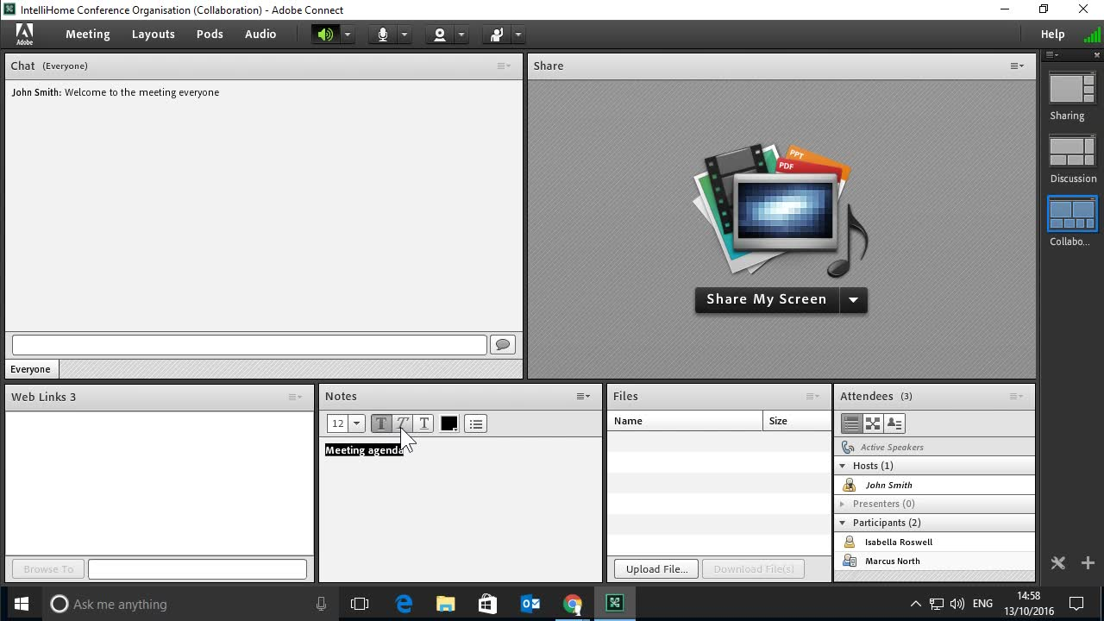
Platforms: Adobe Connect
Notes:
Brandon to lead

Slide 26
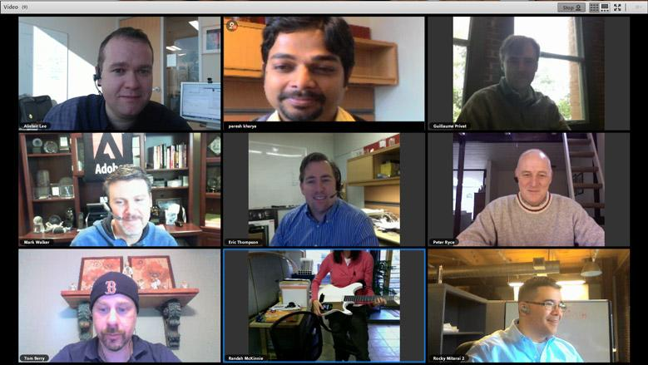
Platforms: Adobe Connect
Notes:
brandon to lead

Slide 27
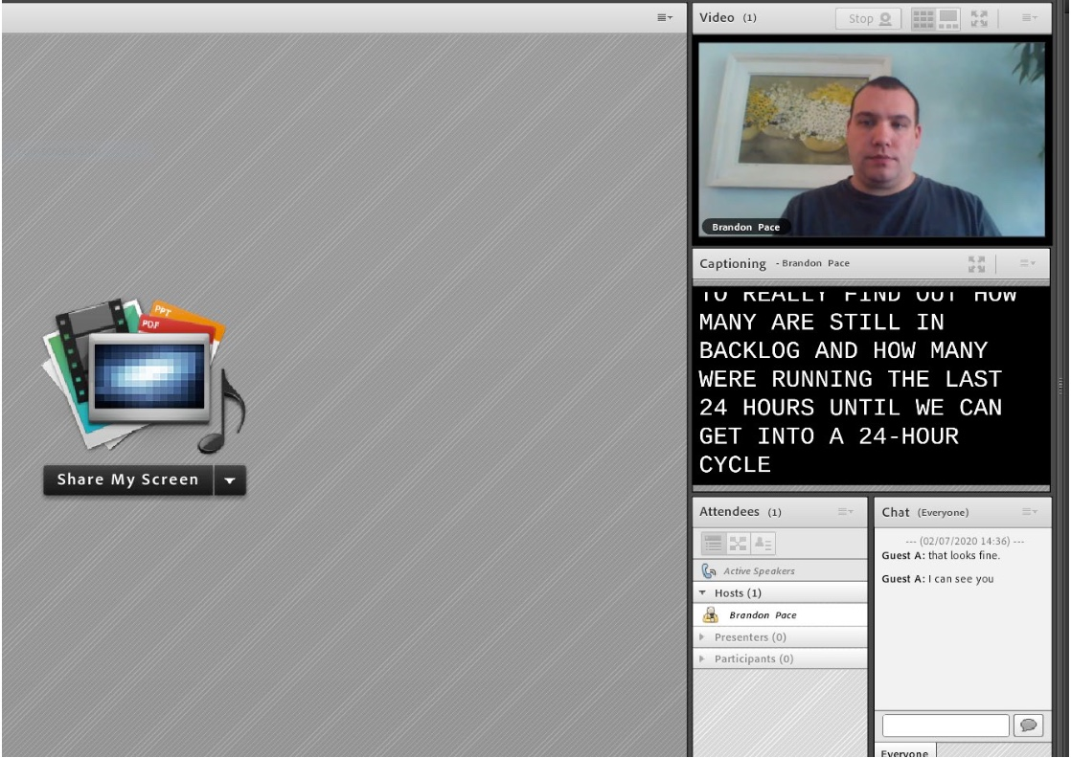
Platforms: Adobe Connect
Notes:
brandon to lead

Slide 28

Platforms: Microsoft Teams
Pros | Cons
Easy to procure; security and enterprise ready Available to almost all government agencies with Office 365 Built-in across Office 365 applications for real-time collaboration Embedded invite for one click meetings via Outlook Multi-pinning enabled | “All-in-one” platform with numerous features that may confuse users Accessibility issues (e.g. guests unable to pin, unreliable captioning, screen reader access) Not user-friendly & not intuitive Captioning only feasible using their Azure AI; no other way to feed captions from CART provider License dilemma to obtain alternative methods for accommodations
Notes:
Brandon to lead
Product not very accessible/usable for screenreader users (though Microsoft is aware of issues and providing training, working on fixes)
Brandon to explain more about G1/G3/G5 licensing dilemma
Both Microsoft and the U.S. Federal Government are coordinating where multiple accessibility defects are being resolved. While I wish I can share more information, what I can share at this time is that Microsoft is actively working to fill in the gaps to improve the user experience for people with disabilities.

Slide 29
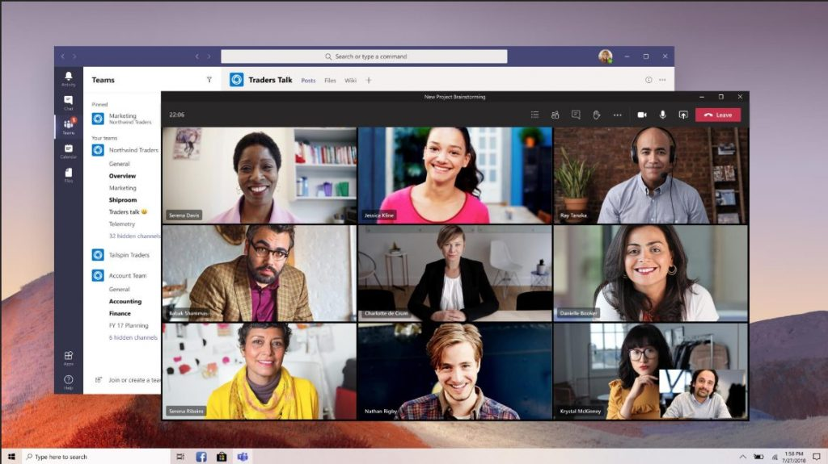
Platforms: Microsoft Teams
Notes:
Brandon to lead

Slide 30
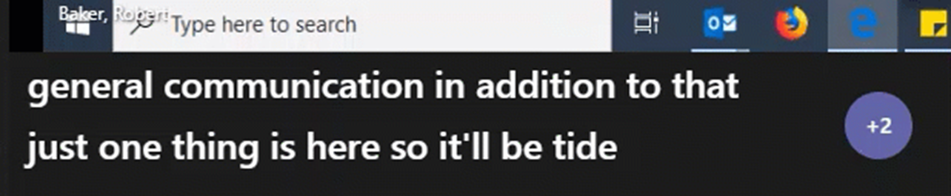
Platforms: Microsoft Teams (Captioning example)
*unedited, real-time 58 seconds video
Notes:
Brandon to lead
In government community cloud (GCC), live captioning have been available only for live events on Teams and not regular meetings. That has changed very recently few weeks ago on June 30 where Microsoft finally added the live captions capability to regular Teams meetings. That is a big milestone for many of us here in federal agencies as our dependency upon Team has become more and more. However, it’s still in its beta preview stage and as you can see the video, captioning would work for few seconds until it freezes and disappears for few seconds when the person is still talking. Microsoft is very aware of this issue and they confirmed it’s still a work in progress.

Slide 31



Platforms: Live Streaming
Pros | Cons
Less bandwidth More control of broadcasting various content and video feeds to audience, especially picture-in-picture ASL interpreter and burn-on captioning Ease of access to virtually everybody who have a computer or mobile device | Requires many moving parts along with technical-intensive knowledge to implement solutions, especially with accessibility Burn-in or embedded captions on streams are not accessible to screen reader or refreshable braille display users Streaming services can be over reliant on ASR generated captioning Does not allow for a great degree of user customization
Notes:
Gerard to lead
Recommend maintaining the video conference interface for participants/speakers only, stream the content of the conference
Ensure that captions are available in alternative form that is screen reader friendly (e.g. Streamtext) while feeding captions to multiple platforms at the same time

Slide 32
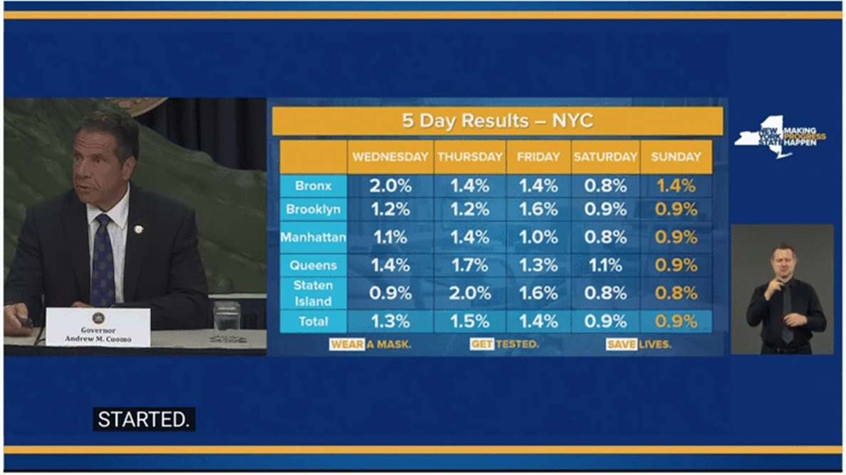
Platforms: Live Streaming (Bad example)
Notes:
Brandon to lead
ASL = way too small
Captions = pop-out, not scrolling, and sometimes would show up and disappear too fast, not allowing people to finish reading what’s being said

Slide 33
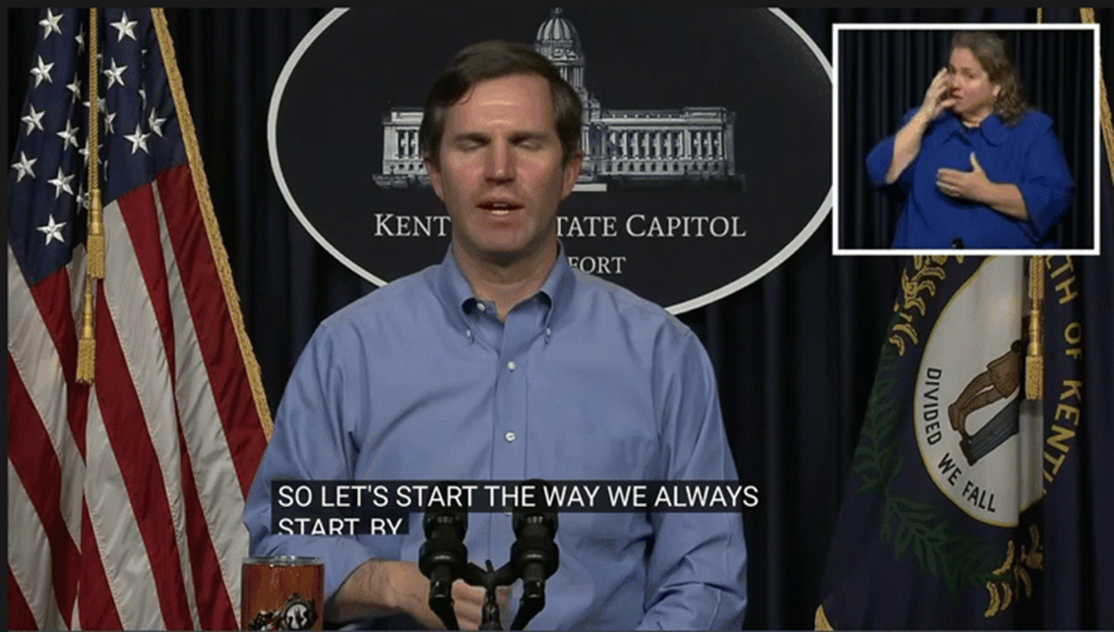
Platforms: Live Streaming (Good example)
Notes:
Gerard to lead
ASL = picture-in-picture while making it large enough for it to be visible even on a small mobile device like an iPhone.
Captioning = used built in platform’s captioning feed - which allows DeafBlind population to customize their styling preferences for better viewing experience (unlike Zoom or Teams)
Notice the scrolling captioning? Much better so people can read at their own pace

Slide 34
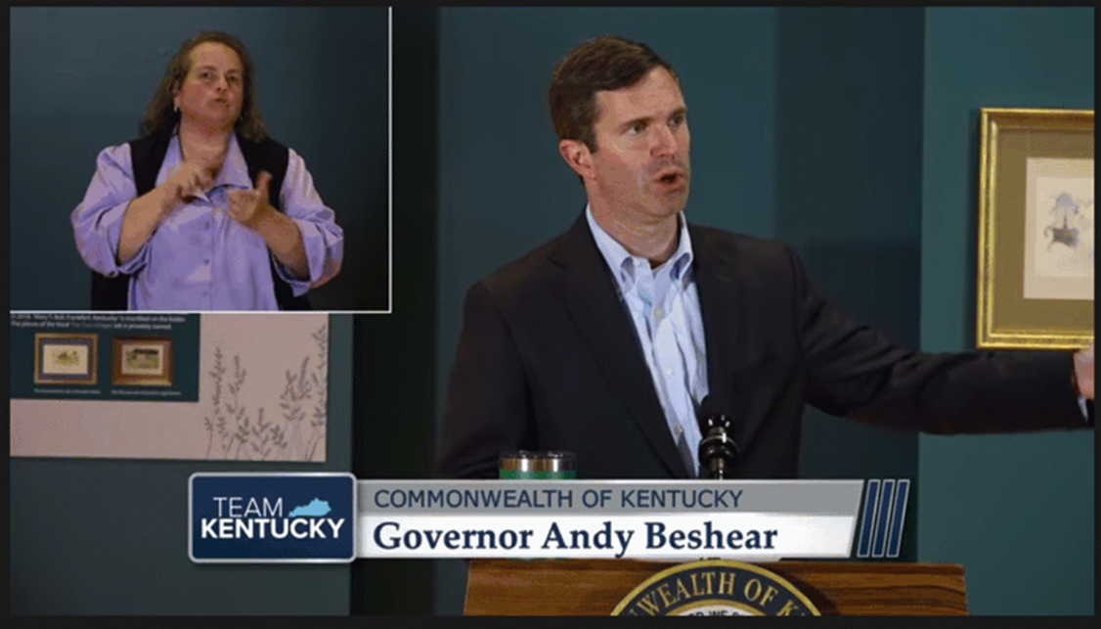
Platforms: Live Streaming (Size & Transition)
Notes:
Gerard to lead
This video did have captioning - I turned it off to show you the slide transition and the size chose for representation
Take a close look where the interpreter and the Governor are almost (or is) the same size. It is an indication that the message being conveyed by these 2 people in the same amount/size using different languages representing accessibility, equity and inclusion.
Also, when they make a transition to show a slide, they do not resize the interpreter which is also a great representation for accessibility

Slide 35
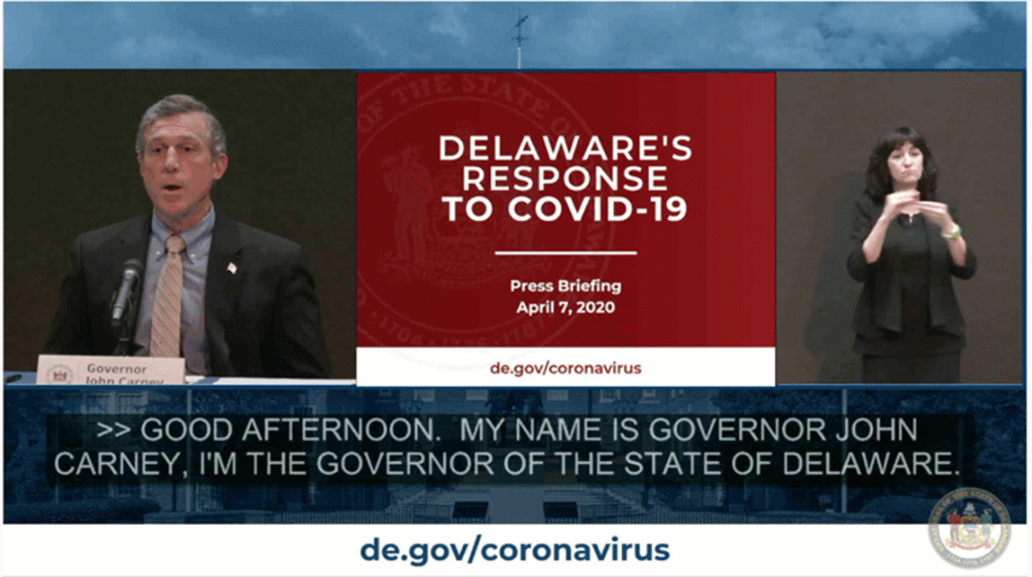
Platforms: Live Streaming (Burn-on Captions)
Notes:
Brandon to lead
It’s AWESOME to have burn-on captions for many reasons… burn-on captions allows media specialists to broadcast out a single video feed to multiple platforms without worrying about accommodating the configuration differences in various platforms’ captioning. For example, Facebook and Twitter have different ways on how to receive the captions feed, and it’s already difficult enough to configure the caption feed to send out to a major social media platform, let alone two or more.
HOWEVER, this may come a surprise to you… burn-on captions would be much more accessible for Deaf people who doesn’t have a vision disability. So, that means burn-on captions are still not 100% accessible. In Delaware’s case, the DeafBlind population would have a difficult time reading the captions which was probably set to 75% opacity (25% transparent?). Because there are no caption feeds to a major platform, the DeafBlind population wouldn’t be able to configure the captions to their styling preferences such as changing the font size to a larger text or even the font color to yellow. Hence our recommendation for StreamText URL to be provided in the event’s description at the same time when trying to ingest captions into live streaming platforms at the same time.

Slide 36





Platforms: Virtual Event Platform
Pros | Cons
Less bandwidth More control of broadcasting various content and video feeds to audience, especially picture-in-picture ASL interpreter and burn-on captioning Ease of access to virtually everybody who have a computer or mobile device Some vendors incorporated accessibility features in their platform and/or design | Cost-intensive Requires many moving parts along with technical-intensive knowledge to implement solutions, especially with accessibility Burn-in or embedded captions on streams are not accessible to screen reader or refreshable braille display users Does not allow for a great degree of user customization
Notes:
Basically the pros and cons from YouTube live streaming are very similar for platforms designed to host virtual events. One major difference is that it is very cost-intensive. Many of those companies did not think of accessibility while they built their platform. When I was reaching out to those vendors for quotes and accessibility reviews, one vendor wanted to invest their time and staffing resources to remediate accessibility defects which was a great sign. That vendor actaully created a “picture-in-picture” box for ASL interpreter and users can toggle it on or off and that PIP box can be moved anywhere where you want on the screen. The same thing for captions, although at that time, they’re using ASR but they’re working to add capability for CART stenographers.

Slide 37
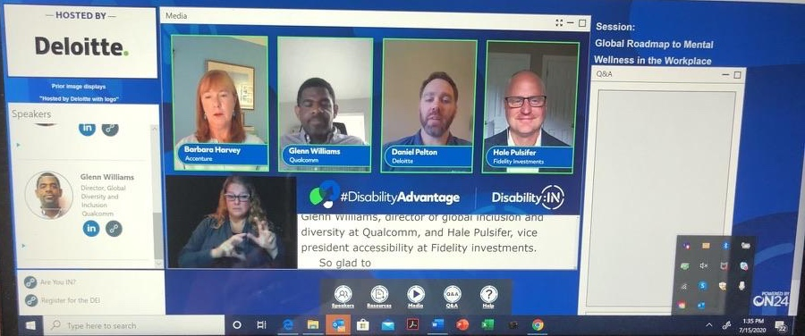
Platforms: Virtual Event Platform
Notes:
Demonstration of panelists with ASL and CC

Slide 38
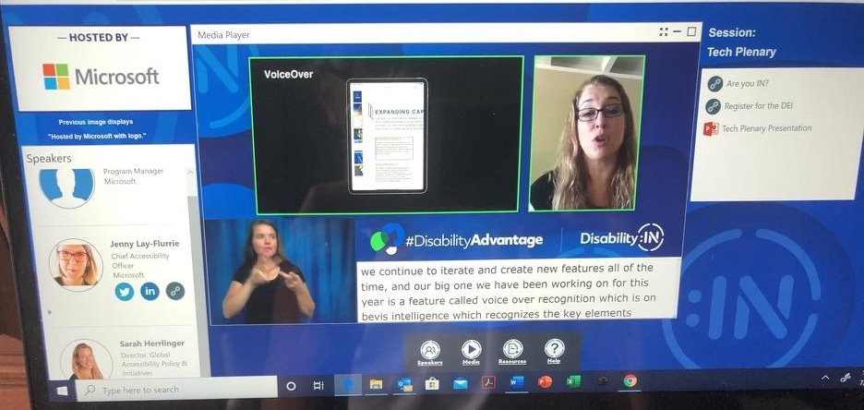
Platforms: Virtual Event Platform
Notes:
Demonstration of PowerPoint slides showing along with the speaker video next to it. Below is ASL and CC support

Slide 39
So how do I pick a platform?
None of the virtual meeting platforms are perfect.
Sorry
Check with your agency/organization to identify which platforms you already have access to
Engage people with disabilities to test and evaluate those platforms with you
Implement meeting management strategies to compensate for weaknesses in your platform
Utilize other services as possible to compensate for weaknesses in your platform (e.g. separate captioning streaming website, hand raising tool)
Notes:
Gerard to lead

Slide 40
Wrap Up
Ask: “How can I help?”
Don’t let the perfect be the enemy of the good, but…
Don’t stop collecting feedback and iterating
Stay flexible
Spend time to save time
Contact Us
Gerard Williams (FCC): gerard.williams@fcc.gov
Brandon Pace (DHS): Brandon.Pace@hq.dhs.gov
Archived Presentation: https://www.accessibilityonline.org/cioc-508/archives/110839
Notes:
Brandon to lead

